Slide 1
Digital Portfolio
STUDENT NAME: sanjai.s
REGISTER NO AND NMID: 35524u09032 & 321B0E1A1FD3F62ADB849A13F9CE665
DEPARTMENT: BCA ll
COLLEGE: COLLEGE/ UNIVERSITY Government Arts and Science College, Tirupattur THIRUVALLUVAR UNIVERSITY

Slide 2
PROJECT TITLE
Digital products management

Slide 3


AGENDA
Problem Statemet Project Overview
End Users Tools and Technologies Portfolio design and Layout Features and Functionality Results and Screenshots Conclusion
Github Link
3/21/2024 Annual Review

Slide 4

PROBLEM STATEMENT
problem statement is a clear, concise description of the issue(s) that need to be addressed by a project, research, or solution. It usually explains: 1. What the problem is 2. Why it’s a problem 3. Who is affected by it 4. What the ideal solution should achieve

Slide 5

PROJECT OVERVIEW
Overview: This project aims to address the problem of [state the problem]. Currently, [explain the issue and why it is important]. To overcome this challenge, the project proposes [your solution/approach]. The system will [explain how it works briefly].

Slide 6

WHO ARE THE END USERS?
For a Digital Portfolio Project: The end users are: 1. Students – to showcase academic achievements, projects, and skills. 2. Job Seekers – to present their work experience, certifications, and career highlights. 3. Professionals/Freelancers – to display portfolios for clients and employers. 4. Employers/Recruiters – to evaluate candidates’ skills and creativity more effectively. 5. Academic Institutions – to review student projects and performance.

Slide 7

TOOLS AND TECHNIQUES
Tools and Technologies: 1. Frontend Development: HTML5 (structure) CSS3 (styling & layout) JavaScript (interactivity) Bootstrap / Tailwind CSS (responsive design) 2. Backend Development (if required): PHP / Node.js / Python (Django/Flask) MySQL / MongoDB (database for user data & projects) 3. Development Tools: VS Code / Sublime Text (code editor) Git & GitHub (version control & collaboration) 4. Design Tools: Figma / Canva / Adobe XD (UI/UX design) 5. Deployment / Hosting: GitHub Pages / Netlify / Vercel (for static sites) AWS / Heroku (for dynamic sites with backend) 6. Other Technologies (optional): React.js / Angular (for advanced frontend features) APIs (for integrating social links, resumes, or certificates)

Slide 8
POTFOLIO DESIGN AND LAYOUT
Portfolio Design & Layout Clean, responsive UI Sections: About, Skills, Projects, Contact Visual elements: images, icons, charts Easy navigation
8

Slide 9
FEATURES AND FUNCTIONALITY
User profile creation Project uploads with media Resume integration Contact form / links Responsive design (mobile-friendly)

Slide 10

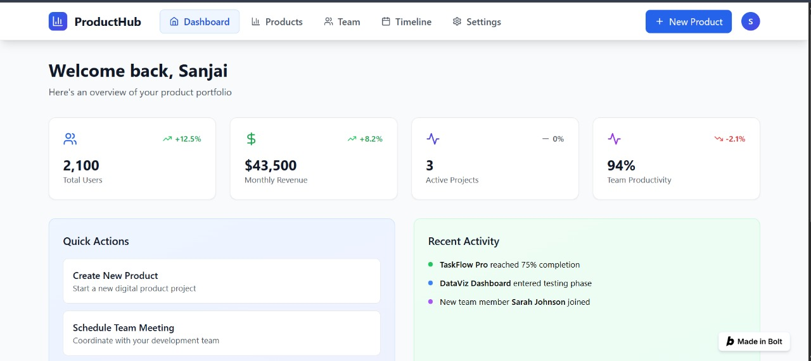
RESULTS AND SCREENSHOTS
Results & Screenshots Working portfolio website Sample student profile Project showcase section Interactive dashboard
3/21/2024 Annual Review
10

Slide 11
CONCLUSION
Digital portfolios solve resume limitations Enhances career visibility Scalable & customizable platform Useful for students &
11

Slide 12
GITHUB LINK
https://github.com/24bcanm32-create/Naan-mudhalvan-SANJAI.git

